Slide 1
Final Proyect

Slide 2
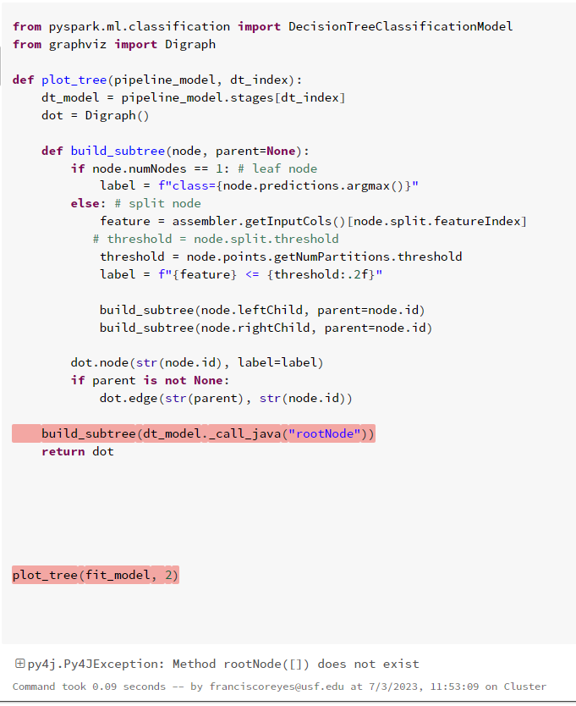
Decision Tree Classifier
from pyspark.ml.classification import DecisionTreeClassificationModel
from graphviz import Digraph
def plot_tree(pipeline_model, dt_index):
dt_model = pipeline_model.stages[dt_index]
dot = Digraph()
def build_subtree(node, parent=None):
if node.numNodes == 1: # leaf node
label = f"class={node.predictions.argmax()}"
else: # split node
feature = assembler.getInputCols()[node.split.featureIndex]
# threshold = node.split.threshold
threshold = node.points.getNumPartitions.threshold
label = f"{feature} <= {threshold:.2f}"
build_subtree(node.leftChild, parent=node.id)
build_subtree(node.rightChild, parent=node.id)
dot.node(str(node.id), label=label)
if parent is not None:
dot.edge(str(parent), str(node.id))
build_subtree(dt_model._call_java("rootNode"))
return dot
plot_tree(fit_model, 2)

Slide 3
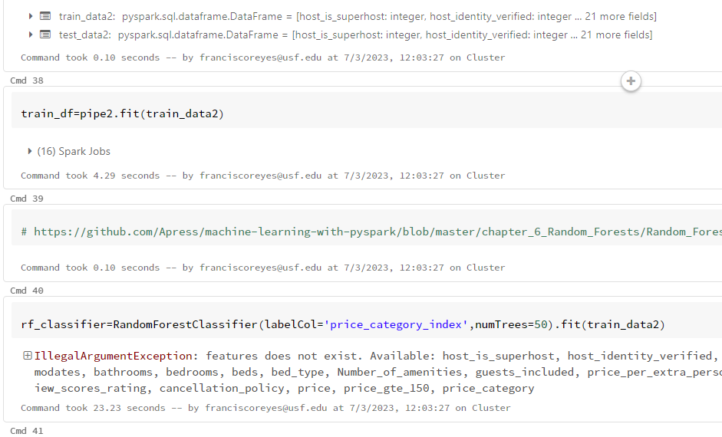
Random Forest

Slide 4
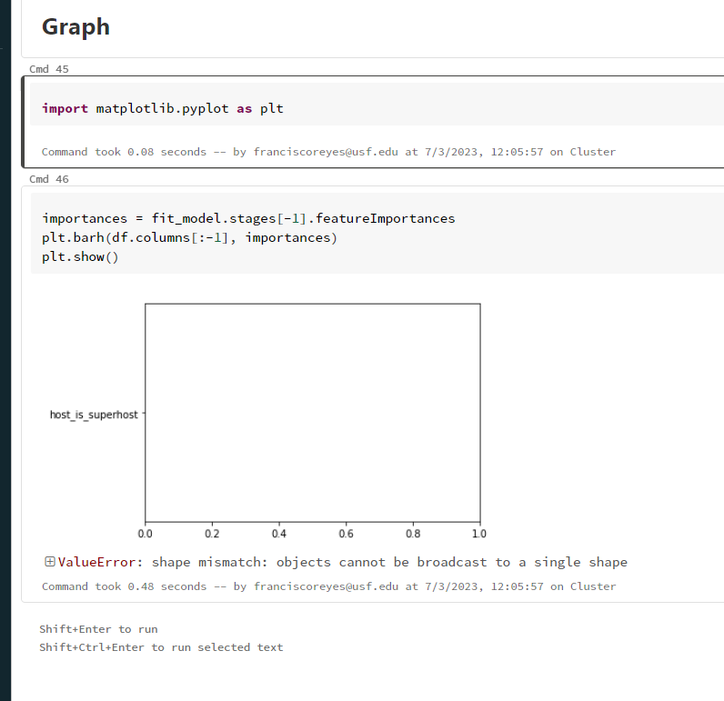
Random Forest

Slide 5
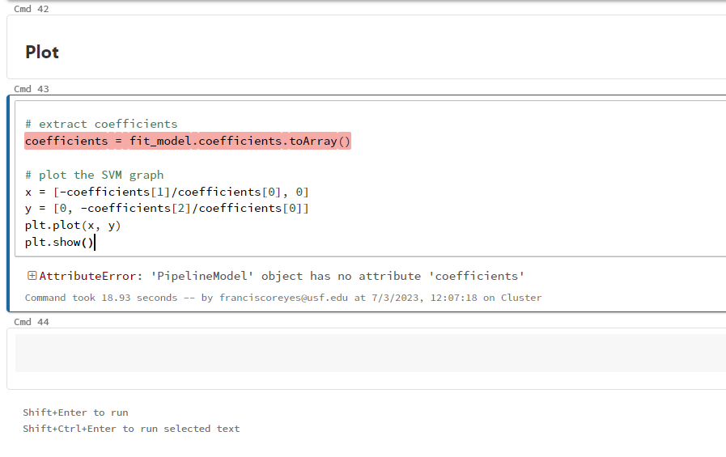
SVM

